Slide 1
Module III
Graph

Slide 2
Graph
A graph can be defined as group of vertices and edges that are used to connect these vertices. A graph can be seen as a cyclic tree, where the vertices (Nodes) maintain any complex relationship among them instead of having parent child relationship.

Slide 3
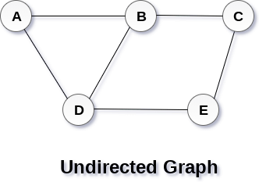
Definition
A graph G can be defined as an ordered set G(V, E) where V(G) represents the set of vertices and E(G) represents the set of edges which are used to connect these vertices.
A Graph G(V, E) with 5 vertices (A, B, C, D, E) and six edges ((A,B), (B,C), (C,E), (E,D), (D,B), (D,A)) is shown in the following figure.

Slide 4
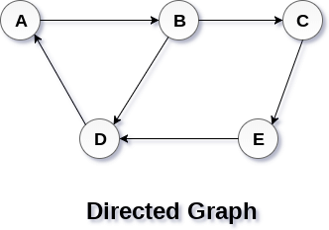
Directed and Undirected Graph
In a directed graph, edges form an ordered pair. Edges represent a specific path from some vertex A to another vertex B. Node A is called initial node while node B is called terminal node.
A graph can be directed or undirected. However, in an undirected graph, edges are not associated with the directions with them. An undirected graph is shown in the above figure since its edges are not attached with any of the directions. If an edge exists between vertex A and B then the vertices can be traversed from B to A as well as A to B.

Slide 5
Types of Graphs

Slide 6
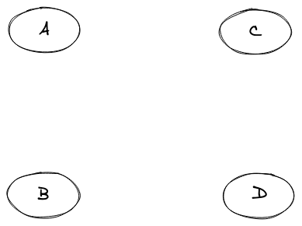
1. Null Graphs
A graph is said to be null if there are no edges in that graph.
A pictorial representation of the null graph is given below:

Slide 7
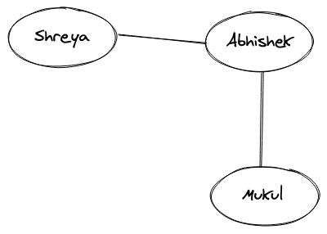
2. Undirected Graphs
If we take a look at the pictorial representation that we had in the Real-world example above, we can clearly see that different nodes are connected by a link (i.e. edge) and that edge doesn't have any kind of direction associated with it. For example, the edge between "Anuj" and "Deepak" is bi-directional and hence the relationship between them is two ways, which turns out to be that "Anuj" knows "Deepak" and "Deepak" also knows about "Anuj". These types of graphs where the relation is bi-directional or there is not a single direction, are known as Undirected graphs.

Slide 8
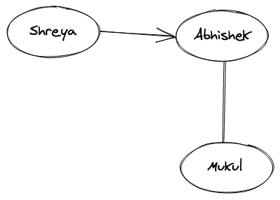
3. Directed Graphs
What if the relation between the two people is something like, "Shreya" know "Abhishek" but "Abhishek" doesn't know "Shreya". This type of relationship is one-way, and it does include a direction. The edges with arrows basically denote the direction of the relationship and such graphs are known as directed graphs.

Slide 9
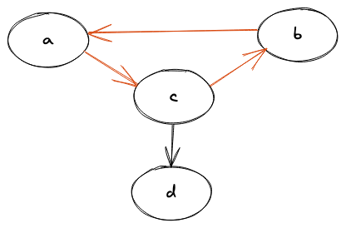
4. Cyclic Graph
A graph that contains at least one node that traverses back to itself is known as a cyclic graph. In simple words, a graph should have at least one cycle formation for it to be called a cyclic graph.
It can be easily seen that there exists a cycle between the nodes (a, b, c) and hence it is a cyclic graph.

Slide 10
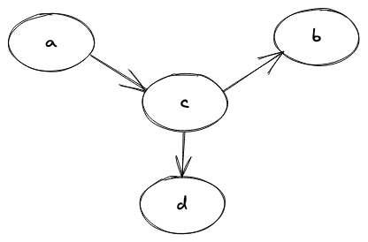
5. Acyclic Graph
A graph where there's no way we can start from one node and can traverse back to the same one, or simply doesn't have a single cycle is known as an acyclic graph.

Slide 11
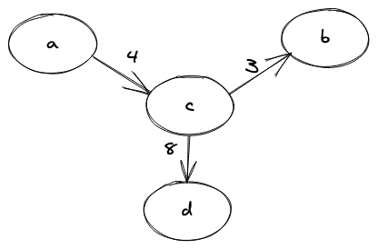
6. Weighted Graph
When the edge in a graph has some weight associated with it, we call that graph as a weighted graph. The weight is generally a number that could mean anything, totally dependent on the relationship between the nodes of that graph.

Slide 12
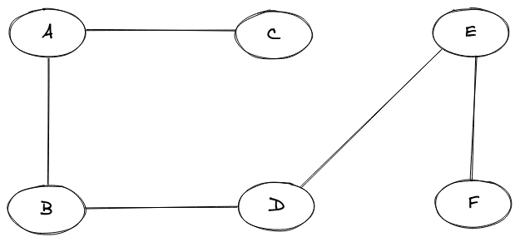
7. Connected Graph
A graph where we have a path between every two nodes of the graph is known as a connected graph. A path here means that we are able to traverse from a node "A" to say any node "B". In simple terms, we can say that if we start from one node of the graph we will always be able to traverse to all the other nodes of the graph from that node, hence the connectivity.

Slide 13
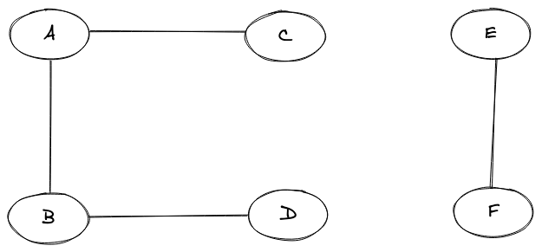
8. Disconnected Graph
A graph that is not connected is simply known as a disconnected graph. In a disconnected graph, we will not be able to find a path from between every two nodes of the graph.

Slide 14
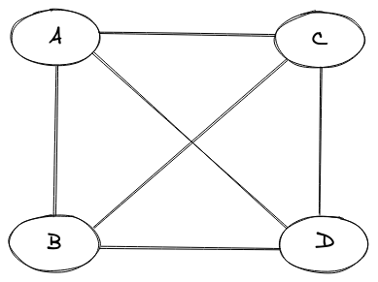
9. Complete Graph
A graph is said to be a complete graph if there exists an edge for every pair of vertices(nodes) of that graph.

Slide 15
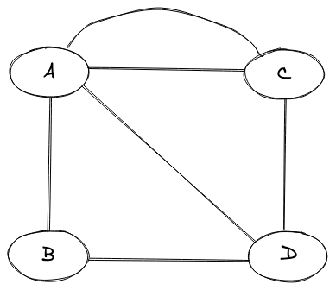
10. Multigraph
A graph is said to be a multigraph if there exist two or more than two edges between any pair of nodes in the graph.

Slide 16
Commonly Used Graph Terminologies
Path - A sequence of alternating nodes and edges such that each of the successive nodes are connected by the edge.
Cycle - A path where the starting and the ending node is the same.
Simple Path - A path where we do not encounter a vertex again.
Bridge - An edge whose removal will simply make the graph disconnected.
Forest - A forest is a graph without cycles.
Tree - A connected graph that doesn't have any cycles.
Degree - The degree in a graph is the number of edges that are incident on a particular node.
Neighbour - We say vertex "A" and "B" are neighbours if there exists an edge between them.

Slide 17
Graph Representation
In graph theory, a graph representation is a technique to store graph into the memory of computer.
To represent a graph, we just need the set of vertices, and for each vertex the neighbors of the vertex (vertices which is directly connected to it by an edge). If it is a weighted graph, then the weight will be associated with each edge.
There are different ways to optimally represent a graph, depending on the density of its edges, type of operations to be performed and ease of use.
Adjacency matrix
Incidence matrix
Adjacency list.

Slide 18
1. Adjacency Matrix
Adjacency matrix is a sequential representation.
It is used to represent which nodes are adjacent to each other. i.e. is there any edge connecting nodes to a graph.
In this representation, we have to construct a nXn matrix A. If there is any edge from a vertex i to vertex j, then the corresponding element of A, a^{i},^{j} = 1, otherwise a^{i},^{j}= 0.
If there is any weighted graph then instead of 1s and 0s, we can store the weight of the edge.
Note,- even if the graph on 100 vertices contains only 1 edge, we still have to have a 100x100 matrix with lots of zeroes.

Slide 19
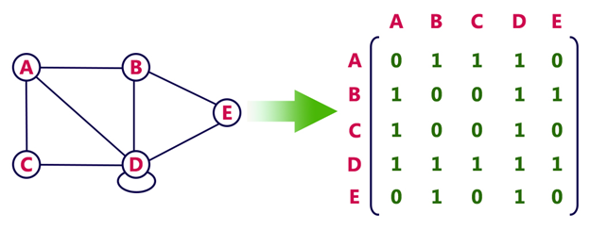
Example-Undirected graph representation

Slide 20
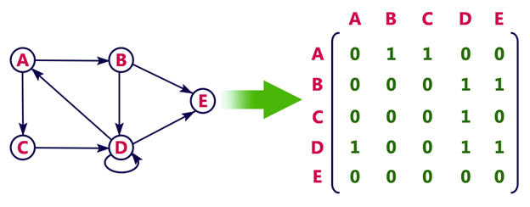
Example - Directed graph representation-
In the above examples, 1 represents an edge from row vertex to column vertex, and 0 represents no edge from row vertex to column vertex.

Slide 21
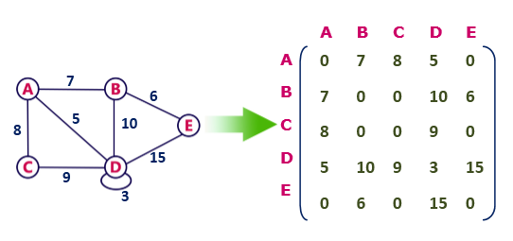
Undirected weighted graph represenation

Slide 22
Advantages: Representation is easier to implement and follow.
Disadvantages: It takes a lot of space and time to visit all the neighbors of a vertex, we have to traverse all the vertices in the graph, which takes quite some time.

Slide 23
2. Incidence Matrix
Total number of vertices by total number of edges.
It means if a graph has 4 vertices and 6 edges, then it can be represented using a matrix of 4X6 class. In this matrix, columns represent edges and rows represent vertices.
This matrix is filled with either 0 or 1 or -1. Where,
0 is used to represent row edge which is not connected to column vertex.
1 is used to represent row edge which is connected as outgoing edge to column vertex.
-1 is used to represent row edge which is connected as incoming edge to column vertex.

Slide 24
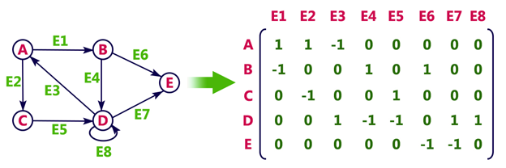
Example

Slide 25
3. Adjacency List
Adjacency list is a linked representation.
In this representation, for each vertex in the graph, we maintain the list of its neighbors. It means, every vertex of the graph contains list of its adjacent vertices.
We have an array of vertices which is indexed by the vertex number and for each vertex v, the corresponding array element points to a singly linked list of neighbors of v.

Slide 26
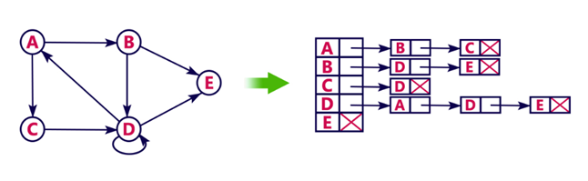
Example
Let's see the following directed graph representation implemented using linked list:

Slide 27
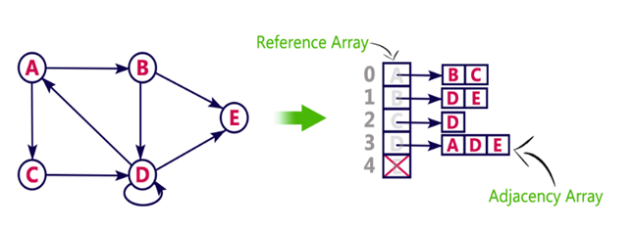
We can also implement this representation using array as follows:

Slide 28
Advantages
Adjacency list saves lot of space.
We can easily insert or delete as we use linked list.
Such kind of representation is easy to follow and clearly shows the adjacent nodes of node.
Disadvantages
The adjacency list allows testing whether two vertices are adjacent to each other but it is slower to support this operation.

Slide 29
Applications of graphs
In Computer science graphs are used to represent the flow of computation.
Google maps uses graphs for building transportation systems, where intersection of two(or more) roads are considered to be a vertex and the road connecting two vertices is considered to be an edge, thus their navigation system is based on the algorithm to calculate the shortest path between two vertices.
In Facebook, users are considered to be the vertices and if they are friends then there is an edge running between them. Facebook’s Friend suggestion algorithm uses graph theory. Facebook is an example of undirected graph.
In World Wide Web, web pages are considered to be the vertices. There is an edge from a page u to other page v if there is a link of page v on page u. This is an example of Directed graph. It was the basic idea behind Google Page Ranking Algorithm.

Slide 30
Applications of graphs
In Operating System, we come across the Resource Allocation Graph where each process and resources are considered to be vertices. Edges are drawn from resources to the allocated process, or from requesting process to the requested resource. If this leads to any formation of a cycle then a deadlock will occur.
In mapping system we use graph. It is useful to find out which is an excellent place from the location as well as your nearby location. In GPS we also use graphs.
Facebook uses graphs. Using graphs suggests mutual friends. it shows a list of the f following pages, friends, and contact list.
Microsoft Excel uses DAG means Directed Acyclic Graphs.
In the Dijkstra algorithm, we use a graph. we find the smallest path between two or many nodes.
On social media sites, we use graphs to track the data of the users. liked showing preferred post suggestions, recommendations, etc.

Slide 31
Traversals: Breadth First Search, Depth First Search.

Slide 32
Graph Traversal Algorithm
In this part of the tutorial we will discuss the techniques by using which, we can traverse all the vertices of the graph.
Traversing the graph means examining all the nodes and vertices of the graph. There are two standard methods by using which, we can traverse the graphs. Lets discuss each one of them in detail.
Breadth First Search
Depth First Search

Slide 33
Breadth First Search (BFS) Algorithm
Breadth first search is a graph traversal algorithm that starts traversing the graph from root node and explores all the neighbouring nodes. Then, it selects the nearest node and explore all the unexplored nodes. The algorithm follows the same process for each of the nearest node until it finds the goal.
The algorithm of breadth first search is given below. The algorithm starts with examining the node A and all of its neighbours. In the next step, the neighbours of the nearest node of A are explored and process continues in the further steps. The algorithm explores all neighbours of all the nodes and ensures that each node is visited exactly once and no node is visited twice.

Slide 34
Algorithm
Step 1: SET STATUS = 1 (ready state) for each node in G
Step 2: Enqueue the starting node A and set its STATUS = 2 (waiting state)
Step 3: Repeat Steps 4 and 5 until QUEUE is empty
Step 4: Dequeue a node N. Process it and set its STATUS = 3 (processed state).

Slide 35
Step 5: Enqueue all the neighbours of N that are in the ready state (whose STATUS = 1) and set their STATUS = 2 (waiting state) [END OF LOOP]
Step 6: EXIT

Slide 36
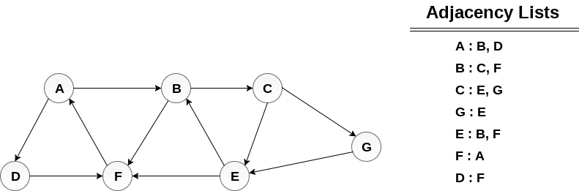
Example
Consider the graph G shown in the following image, calculate the minimum path p from node A to node E. Given that each edge has a length of 1.

Slide 37
Solution:
Minimum Path P can be found by applying breadth first search algorithm that will begin at node A and will end at E. the algorithm uses two queues, namely QUEUE1 and QUEUE2. QUEUE1 holds all the nodes that are to be processed while QUEUE2 holds all the nodes that are processed and deleted from QUEUE1.

Slide 38
Lets start examining the graph from Node A.
1. Add A to QUEUE1 and NULL to QUEUE2.
QUEUE1 = {A}
QUEUE2 = {NULL}
2. Delete the Node A from QUEUE1 and insert all its neighbours. Insert Node A into QUEUE2
QUEUE1 = {B, D}
QUEUE2 = {A}

Slide 39
3. Delete the node B from QUEUE1 and insert all its neighbours. Insert node B into QUEUE2.
QUEUE1 = {D, C, F}
QUEUE2 = {A, B}
4. Delete the node D from QUEUE1 and insert all its neighbours. Since F is the only neighbour of it which has been inserted, we will not insert it again. Insert node D into QUEUE2.
QUEUE1 = {C, F}
QUEUE2 = { A, B, D}
5. Delete the node C from QUEUE1 and insert all its neighbours. Add node C to QUEUE2.

Slide 40
QUEUE1 = {F, E, G}
QUEUE2 = {A, B, D, C}
6. Remove F from QUEUE1 and add all its neighbours. Since all of its neighbours has already been added, we will not add them again. Add node F to QUEUE2.
QUEUE1 = {E, G}
QUEUE2 = {A, B, D, C, F}

Slide 41
7. Remove E from QUEUE1, all of E's neighbours has already been added to QUEUE1 therefore we will not add them again. All the nodes are visited and the target node i.e. E is encountered into QUEUE2.
QUEUE1 = {G}
QUEUE2 = {A, B, D, C, F, E}
Now, backtrack from E to A, using the nodes available in QUEUE2.
The minimum path will be A → B → C → E.

Slide 42
Depth First Search (DFS) Algorithm
Depth first search (DFS) algorithm starts with the initial node of the graph G, and then goes to deeper and deeper until we find the goal node or the node which has no children. The algorithm, then backtracks from the dead end towards the most recent node that is yet to be completely unexplored.
The data structure which is being used in DFS is stack. The process is similar to BFS algorithm. In DFS, the edges that leads to an unvisited node are called discovery edges while the edges that leads to an already visited node are called block edges.

Slide 43
Algorithm
Step 1: SET STATUS = 1 (ready state) for each node in G
Step 2: Push the starting node A on the stack and set its STATUS = 2 (waiting state)
Step 3: Repeat Steps 4 and 5 until STACK is empty
Step 4: Pop the top node N. Process it and set its STATUS = 3 (processed state)
Step 5: Push on the stack all the neighbours of N that are in the ready state (whose STATUS = 1) and set their
STATUS = 2 (waiting state)
[END OF LOOP]
Step 6: EXIT

Slide 44
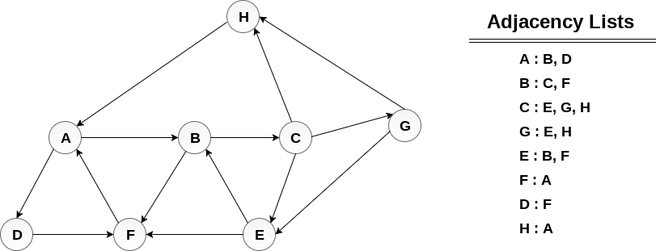
Example :
Consider the graph G along with its adjacency list, given in the figure below. Calculate the order to print all the nodes of the graph starting from node H, by using depth first search (DFS) algorithm.

Slide 45
Solution :
Push H onto the stack
STACK : H
POP the top element of the stack i.e. H, print it and push all the neighbours of H onto the stack that are is ready state.
Print H
STACK : A
Pop the top element of the stack i.e. A, print it and push all the neighbours of A onto the stack that are in ready state.
Print A
Stack : B, D

Slide 46
Pop the top element of the stack i.e. D, print it and push all the neighbours of D onto the stack that are in ready state.
Print D
Stack : B, F
Pop the top element of the stack i.e. F, print it and push all the neighbours of F onto the stack that are in ready state.
Print F
Stack : B
Pop the top of the stack i.e. B and push all the neighbours
Print B
Stack : C

Slide 47
Pop the top of the stack i.e. C and push all the neighbours.
Print C
Stack : E, G
Pop the top of the stack i.e. G and push all its neighbours.
Print G
Stack : E
Pop the top of the stack i.e. E and push all its neighbours.
Print E
Stack :

Slide 48
Hence, the stack now becomes empty and all the nodes of the graph have been traversed.
The printing sequence of the graph will be :
H → A → D → F → B → C → G → E

Slide 49
Differences between BFS and DFS
 | BFS | DFS
Full form | BFS stands for Breadth First Search. | DFS stands for Depth First Search.
Technique | It a vertex-based technique to find the shortest path in a graph. | It is an edge-based technique because the vertices along the edge are explored first from the starting to the end node.
Definition | BFS is a traversal technique in which all the nodes of the same level are explored first, and then we move to the next level. | DFS is also a traversal technique in which traversal is started from the root node and explore the nodes as far as possible until we reach the node that has no unvisited adjacent nodes.
Data Structure | Queue data structure is used for the BFS traversal. | Stack data structure is used for the BFS traversal.
Backtracking | BFS does not use the backtracking concept. | DFS uses backtracking to traverse all the unvisited nodes.
Number of edges | BFS finds the shortest path having a minimum number of edges to traverse from the source to the destination vertex. | In DFS, a greater number of edges are required to traverse from the source vertex to the destination vertex.

Slide 50
Differences between BFS and DFS
 | BFS | DFS
Optimality | BFS traversal is optimal for those vertices which are to be searched closer to the source vertex. | DFS traversal is optimal for those graphs in which solutions are away from the source vertex.
Speed | BFS is slower than DFS. | DFS is faster than BFS.
Suitability for decision tree | It is not suitable for the decision tree because it requires exploring all the neighboring nodes first. | It is suitable for the decision tree. Based on the decision, it explores all the paths. When the goal is found, it stops its traversal.
Memory efficient | It is not memory efficient as it requires more memory than DFS. | It is memory efficient as it requires less memory than BFS.

Slide 51
Minimum Spanning Tree
Spanning Tree
Given a connected and undirected graph, a spanning tree of that graph is a subgraph that is a tree and connects all the vertices together. A single graph can have many different spanning trees.
Properties
A spanning tree does not have any cycle.
Any vertex can be reached from any other vertex.
The cost of the spanning tree is the sum of the weights of all the edges in the tree.
Minimum Spanning Tree (MST)
A minimum spanning tree (MST) or minimum weight spanning tree for a weighted, connected, undirected graph is a spanning tree with a weight less than or equal to the weight of every other spanning tree.
How many edges does a minimum spanning tree has?
A minimum spanning tree has (V – 1) edges where V is the number of vertices in the given graph.

Slide 52
Applications of MST
MST is fundamental problem with diverse applications.
Network design.
– telephone, electrical, hydraulic, TV cable, computer, road
Approximation algorithms for NP-hard problems.
– traveling salesperson problem, Steiner tree
Indirect applications.
– max bottleneck paths
– LDPC codes for error correction
– image registration with Renyi entropy
– learning salient features for real-time face verification
– reducing data storage in sequencing amino acids in a protein
– model locality of particle interactions in turbulent fluid flows
– autoconfig protocol for Ethernet bridging to avoid cycles in a network
Cluster analysis
k clustering problem can be viewed as finding an MST and deleting the k-1 most expensive edges.

Slide 53
Methods for FInding MST using greedy
Prims Algorithm
Prim’s Algorithm reorders its input in order to choose the cheapest edge.
We say that Prim’s Algorithm is an adaptive greedy algorithm; in the sense that, at every iteration, the algorithm tries to readjust the input to its own convenience. In contrast, Kruskal’s Algorithm was non-adaptive, since the algorithm sorts the edges once at the beginning and blindly processes one edge at a time.
I.e prims works on vertices.
Kruskal Algorithm
Kruskal’s Algorithm was non-adaptive, since the algorithm sorts the edges once at the beginning and blindly processes one edge at a time.
I.e. Kruskal works on edges.

Slide 54
Prims Algorithm
It is a greedy algorithm. It starts with an empty spanning tree. The idea is to maintain two sets of vertices:
Contain vertices already included in MST.
Contain vertices not yet included.
At every step, it considers all the edges and picks the minimum weight edge. After picking the edge, it moves the other endpoint of edge to set containing MST.
Steps for finding MST using Prim's Algorithm:
Create MST set that keeps track of vertices already included in MST.
Assign key values to all vertices in the input graph. Initialize all key values as INFINITE (∞). Assign key values like 0 for the first vertex so that it is picked first.
While MST set doesn't include all vertices.
Pick vertex u which is not is MST set and has minimum key value. Include 'u'to MST set.
Update the key value of all adjacent vertices of u. To update, iterate through all adjacent vertices. For every adjacent vertex v, if the weight of edge u.v less than the previous key value of v, update key value as a weight of u.v.

Slide 55
Prims Algorithm
MST-PRIM (G, w, r)
for each u ∈ V [G]
do key [u] ← ∞
π [u] ← NIL
key [r] ← 0
Q ← V [G]
While Q ? ∅
do u ← EXTRACT - MIN (Q)
for each v ∈ Adj [u]
do if v ∈ Q and w (u, v) < key [v]
then π [v] ← u
key [v] ← w (u, v)

Slide 56
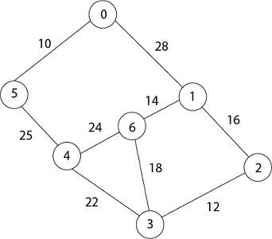
Example

Slide 57


In Prim's algorithm, first we initialize the priority Queue Q. to contain all the vertices and the key of each vertex to ∞ except for the root, whose key is set to 0. Suppose 0 vertex is the root, i.e., r. By EXTRACT - MIN (Q) procure, now u = r and Adj [u] = {5, 1}.
Removing u from set Q and adds it to set V - Q of vertices in the tree. Now, update the key and π fields of every vertex v adjacent to u but not in a tree.

Slide 58


Now by EXTRACT_MIN (Q) Removes 5 because key [5] = 10 which is minimum so u = 5.
Now remove 4 because key [4] = 25 which is minimum, so u =4
Update key value of key [3] as 22 and key [6] as 24.
And the parent of 3, 6 as 4.

Slide 59


Now remove 3 because key [3] = 22 is minimum so u =3.
Now in Q, key [2] = 12, key [6] = 18, key [1] = 28 and parent of 2 and 6 is 3.
π [2] = 3 π[6]=3
Now by EXTRACT_MIN (Q) Removes 2, because key [2] = 12 is minimum.
So update key value of key [1] as 16 and its parent as 2.
π[1]= 2

Slide 60

Now by EXTRACT_MIN (Q) Removes 1 because key [1] = 16 is minimum.
Update key value of 6 as 14 and its parent as 1.
Π [6] = 1
Now all the vertices have been spanned, Using above the table we get Minimum Spanning Tree.
0 → 5 → 4 → 3 → 2 → 1 → 6
[Because Π [5] = 0, Π [4] = 5, Π [3] = 4, Π [2] = 3, Π [1] =2, Π [6] =1]

Slide 61
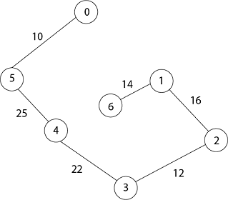
Thus the final spanning Tree is
Total Cost = 10 + 25 + 22 + 12 + 16 + 14 = 99

Slide 62
Another Algorithm
Step-01:
Randomly choose any vertex.
The vertex connecting to the edge having least weight is usually selected.
Step-02:
Find all the edges that connect the tree to new vertices.
Find the least weight edge among those edges and include it in the existing tree.
If including that edge creates a cycle, then reject that edge and look for the next least weight edge.
Step-03:
Keep repeating step-02 until all the vertices are included and Minimum Spanning Tree (MST) is obtained.

Slide 63
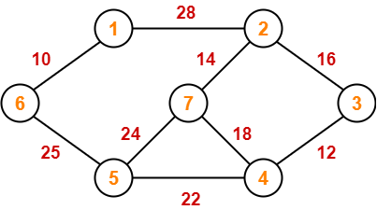
Example

Slide 64
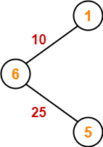
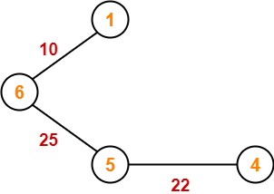
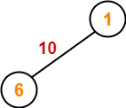
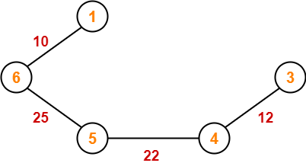
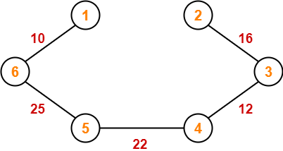
Example

Slide 65
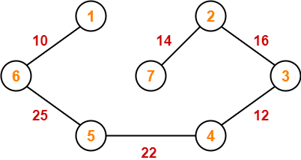
Since all the vertices have been included in the MST, so we stop.
Now, Cost of Minimum Spanning Tree
= Sum of all edge weights
= 10 + 25 + 22 + 12 + 16 + 14
= 99 units

Slide 66
Time complexity analysis
Worst case time complexity of Prim’s Algorithm is-
O(ElogV) using binary heap
O(E + VlogV) using Fibonacci heap
Analysis
If adjacency list is used to represent the graph, then using breadth first search, all the vertices can be traversed in O(V + E) time.
We traverse all the vertices of graph using breadth first search and use a min heap for storing the vertices not yet included in the MST.
To get the minimum weight edge, we use min heap as a priority queue.
Min heap operations like extracting minimum element and decreasing key value takes O(logV) time.
So, overall time complexity
= O(E + V) x O(logV)= O((E + V)logV)= O(ElogV)
This time complexity can be improved and reduced to O(E + VlogV) using Fibonacci heap.

Slide 67
Kruskal Algorithm
An algorithm to construct a Minimum Spanning Tree for a connected weighted graph. It is a Greedy Algorithm. The Greedy Choice is to put the smallest weight edge that does not cause a cycle in the MST constructed so far.
Steps:
Arrange the edge of G in order of increasing weight.
Starting only with the vertices of G and proceeding sequentially add each edge which does not result in a cycle, until (n - 1) edges are used.
EXIT.
Thumb Rule to Remember
The above steps may be reduced to the following thumb rule-
Simply draw all the vertices on the paper.
Connect these vertices using edges with minimum weights such that no cycle gets formed.

Slide 68
Kruskal Algorithm
MST- KRUSKAL (G, w)
. A ← ∅
for each vertex v ∈ V [G]
do MAKE - SET (v)
sort the edges of E into non decreasing order by weight w
for each edge (u, v) ∈ E, taken in non decreasing order by weight
do if FIND-SET (μ) ≠ if FIND-SET (v)
then A ← A ∪ {(u, v)}
UNION (u, v)
return A

Slide 69
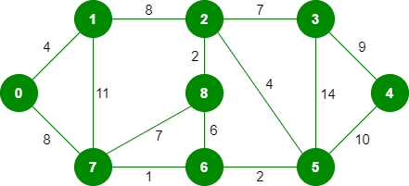
Example

Slide 70
The graph contains 9 vertices and 14 edges. So, the minimum spanning tree formed will be having (9 – 1) = 8 edges.
After sorting:
Weight Src Dest
1 7 6
2 8 2
2 6 5
4 0 1
4 2 5
6 8 6
7 2 3
7 7 8
8 0 7
8 1 2
9 3 4
10 5 4
11 1 7
14 3 5

Slide 71

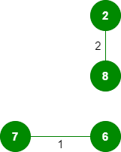
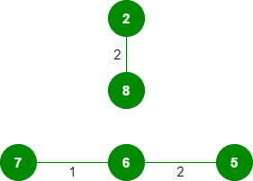
Now pick all edges one by one from the sorted list of edges
1. Pick edge 7-6: No cycle is formed, include it.
2. Pick edge 8-2: No cycle is formed, include it. 3. Pick edge 5-6

Slide 72
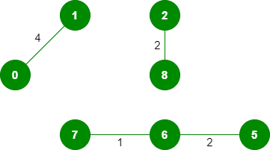

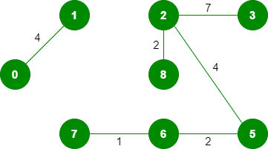
Now pick all edges one by one from the sorted list of edges
4. Pick edge 0-1: No cycle is formed, include it. 5. Pick edge 2-5: No cycle is formed, include it.
6. Pick edge 8-6: Since including this edge results in the cycle, discard it.
7. Pick edge 2-3: No cycle is formed, include it.

Slide 73
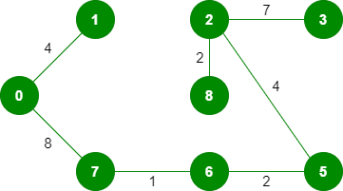
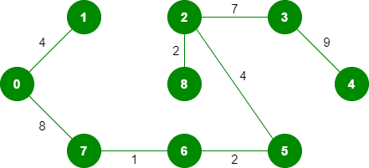
8. Pick edge 7-8: Since including this edge results in the cycle, discard it.
9. Pick edge 0-7: No cycle is formed, include it.
10. Pick edge 1-2: Since including this edge results in the cycle, discard it.
11. Pick edge 3-4: No cycle is formed, include it.

Slide 74
8. Pick edge 7-8: Since including this edge results in the cycle, discard it.
9. Pick edge 0-7: No cycle is formed, include it.
10. Pick edge 1-2: Since including this edge results in the cycle, discard it.
11. Pick edge 3-4: No cycle is formed, include it.
Since the number of edges included equals (V – 1), the algorithm stops here.
Total cost= 4+8+1+2+4+2+7+9=37

Slide 75
Example2

Slide 76
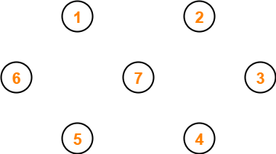
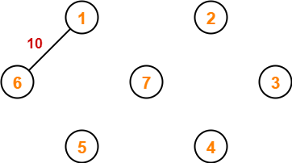
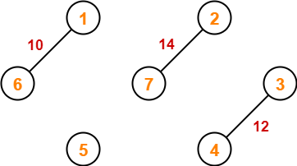
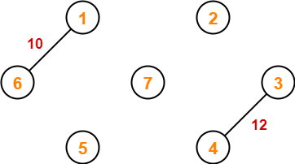

Slide 77
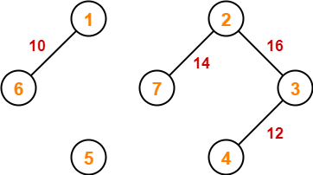
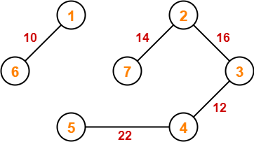
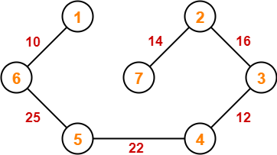
Since all the vertices have been connected / included in the MST, so we stop.
Weight of the MST
= Sum of all edge weights
= 10 + 25 + 22 + 12 + 16 + 14
= 99 units

Slide 78
Time Complexity Analysis
Worst case time complexity of Kruskal’s Algorithm
= O(ElogV) or O(ElogE)
Analysis
The edges are maintained as min heap.
The next edge can be obtained in O(logE) time if graph has E edges.
Reconstruction of heap takes O(E) time.
So, Kruskal’s Algorithm takes O(ElogE) time.
The value of E can be at most O(V²).
So, O(logV) and O(logE) are same.
Special Case-
If the edges are already sorted, then there is no need to construct min heap.
So, deletion from min heap time is saved.
In this case, time complexity of Kruskal’s Algorithm = O(E + V)

Slide 79
Difference between Prims and Kruskal
Prims | Kruskal
The tree that we are making or growing always remains connected. | The tree that we are making or growing usually remains disconnected.
Prim’s Algorithm grows a solution from a random vertex by adding the next cheapest vertex to the existing tree. | Kruskal’s Algorithm grows a solution from the cheapest edge by adding the next cheapest edge to the existing tree / forest.
Prim’s Algorithm is faster for dense graphs. | Kruskal’s Algorithm is faster for sparse graphs.
Works on vertices | Works on edges

Slide 80
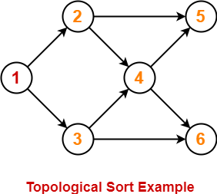
Topological Sorting
Topological Sort is a linear ordering of the vertices in such a way that if there is an edge in the DAG going from vertex ‘u’ to vertex ‘v’, then ‘u’ comes before ‘v’ in the ordering.
Topological Sorting is possible if and only if the graph is a Directed Acyclic Graph.
There may exist multiple different topological orderings for a given directed acyclic graph.
The ordering of the nodes in the array is called a topological ordering.
For this graph, following 4 different topological orderings are possible-
1 2 3 4 5 6
1 2 3 4 6 5
1 3 2 4 5 6
1 3 2 4 6 5

Slide 81
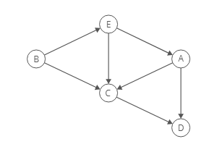
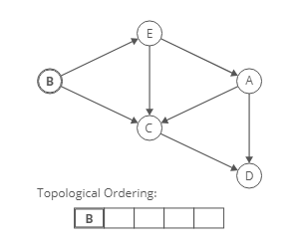
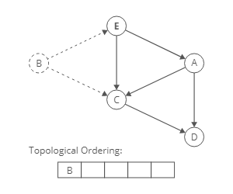
The Algorithm
Select the node that can't have any incoming directed edges; it must have an indegree of zero and add it to the topological ordering.
2) Once a node is added to the topological ordering, we can take the node, and its outgoing edges, out of the graph.

Slide 82
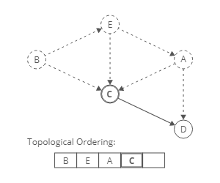
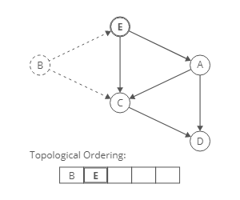
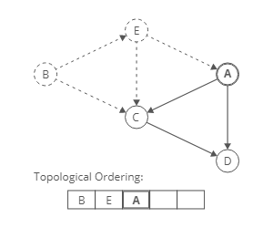
The Algorithm
3) Then, we can repeat our earlier approach: look for any node with an indegree of zero and add it to the ordering.

Slide 83


Slide 84
Implementation
We'll use the strategy we outlined above:
Identify a node with no incoming edges.
Add that node to the ordering.
Remove it from the graph.
Repeat.
We'll keep looping until there aren't any more nodes with indegree zero. This could happen for two reasons:
There are no nodes left. We've taken all of them out of the graph and added them to the topological ordering.
There are some nodes left, but they all have incoming edges. This means the graph has a cycle, and no topological ordering exists.
One small tweak. Instead of actually removing the nodes from the graph (and destroying our input!), we'll use a hash map to track each node's indegree. When we add a node to the topological ordering, we'll decrement the indegree of that node's neighbors, representing that those nodes have one fewer incoming edges.

Slide 85



Example

Slide 86


Example

Slide 87

Example

Slide 88
Applications of Topological Sort-
Few important applications of topological sort are-
Scheduling jobs from the given dependencies among jobs
Instruction Scheduling
Determining the order of compilation tasks to perform in makefiles
Data Serialization

